Slide 1


Elevate Your Potential with Brand U University
Welcome to Brand U University, where we empower individuals to become transformational coaches and branding consultants. Our unique approach combines education, personal branding, and marketing systems to help you reach new heights.

Slide 2

Our Guiding Philosophy: Lift as You Climb
At Brand U University, we believe in collective growth. Our mission is to empower you to reach your potential while creating a community of transformational coaches and branding consultants.
Empowering Growth
Building Community
We provide comprehensive training and tools for personal and professional development.
Our approach fosters a supportive network of like-minded individuals.
Creating Impact
We equip you to make a lasting difference in others' lives.

Slide 3





The Power of Collective Growth
Our core principle is simple: as you rise, you bring others with you. This philosophy creates a ripple effect of success and empowerment throughout our community.
Personal Growth
1
Develop your skills and mindset
2
Empowering Others
Share your knowledge and experiences
3
Community Impact
Create lasting change in lives
4
Industry Transformation
Shape the future of coaching and branding

Slide 4

Your Journey: From Student to Coach
Our comprehensive onboarding process transforms you from a student into a confident, skilled coach. We provide the education, tools, and support you need to succeed.
1
Education & Training
Gain expertise in personal development, leadership, and marketing strategies.
2
Branding & Marketing System
Develop your unique brand and online presence with our guidance.
3
Funnel Setup & Marketing System
Learn to attract, nurture, and convert leads into clients.

Slide 5

Mastering the Tools for Success
We provide you with cutting-edge marketing systems and comprehensive support. Our goal is to ensure you're confident and ready to grow your coaching practice.
Training on Tools
Support System
Learn to navigate social media strategies, email campaigns, and lead generation techniques. Our expert-led sessions ensure you master these essential skills.
Enjoy step-by-step guidance from our experienced mentors. We're here to answer questions and help you overcome challenges as you build your practice.

Slide 6




Building Your Powerful Brand
Your brand is your business card to the world. Our branding system ensures you stand out and make a lasting impression on potential clients.
Social Media Presence
Learn to craft a compelling online persona across all major platforms.
Free Ebook Creation
Design and distribute valuable content that showcases your expertise.
Brand Identity
Develop a unique visual style that resonates with your target audience.

Slide 7


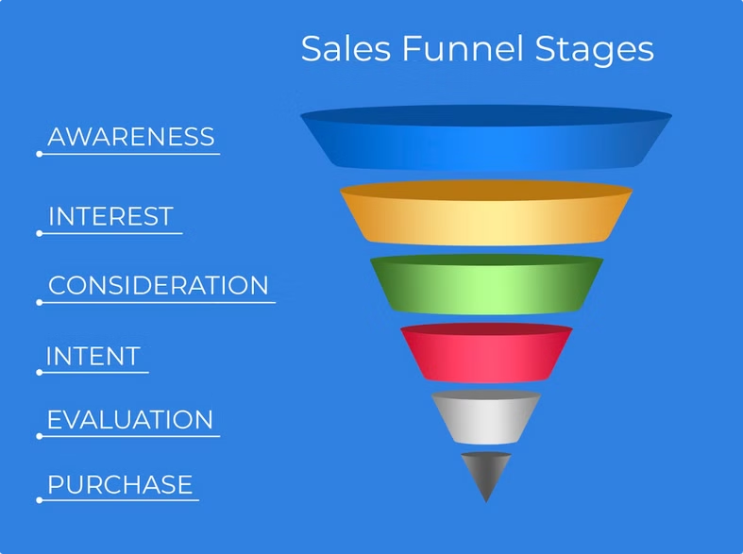



Turning Prospects into Clients
Our funnel setup and follow-up system teach you how to attract, nurture, and convert prospects into loyal clients. We provide ongoing support to refine your process.
Funnel Design
Create an automated system to attract and engage potential clients.
Lead Nurturing
Develop strategies to build relationships with prospects over time.
Effective Follow-Up
Learn techniques to overcome objections and close deals confidently.
Continuous Optimization
Refine your approach based on data and feedback.

Slide 8

Building Strong Client Relationships
We show you how to onboard clients effectively and build lasting relationships. Our approach ensures clients feel supported from day one and throughout their journey.
Smooth Onboarding
Trust Building
Learn to create a welcoming experience that sets the tone for success.
Develop techniques to establish credibility and rapport with clients.
Value-Driven Coaching
Long-Term Engagement
Discover how to consistently deliver results that exceed expectations.
Strategies for maintaining strong relationships and encouraging referrals.

Slide 9

Your Transformation Starts Now
Are you ready to climb higher and lift others with you? Join Brand U University today and embark on a journey that will transform your life and the lives of others.
1
Enroll
Take the first step towards your new career.
2
Learn
Absorb knowledge from industry experts.
3
Apply
Put your skills into practice.
4
Succeed
Achieve your goals and help others do the same.

Slide 10

Join Our Community of Transformation
At Brand U University, you're not just a student – you're part of a movement. Together, we'll create a ripple effect of positive change in the world.
1000+
Graduates
Join our growing network of successful coaches and consultants.
97%
Satisfaction Rate
Our students love the transformative experience we provide.
$100K+
Potential Earnings
Many graduates achieve six-figure incomes inside of 2 years.

